Slide 1
Pitfalls in the interpretation of Troponins and BNP
Dr Joe Martins MD, FRCP
Consultant Interventional Cardiologist
Dudley Group of Hospitals,
NHS Foundation Trust

Slide 2
Why and when to use Troponin and BNP?

Slide 3
The cynics view
BNP is used to ration echocardiography
HsTns are used to discharge patients without the fear of being sued when they’re normal
and to turf to someone else when they’re raised

Slide 4
The clinical view
BNP can help differentiate acute HF from non-cardiac causes in patients presenting with acute dyspnoea
Troponins are integral to the diagnosis of myocardial infarction and are used to risk-stratify and determine further management of patients with ACS

Slide 5
What is heart failure (HF)?
“HF is a clinical syndrome characterized by typical symptoms (e.g. breathlessness, ankle swelling and fatigue) that may be accompanied by signs (e.g. elevated jugular venous pressure, pulmonary crackles and peripheral oedema) caused by a structural and/or functional cardiac abnormality, resulting in a reduced cardiac output and/or elevated intracardiac pressures at rest or during stress”
2016 ESC Guidelines for the diagnosis and treatment of acute and chronic heart failure. European Heart Journal (2016) 37, 2129–2200

Slide 6
Terminology
HF with reduced EF (HFrEF) – LV systolic impairment, EF<40%
HF with preserved EF (HFpEF) – EF≥50% (diastolic HF)
HF with mid-range EF (HFmrEF) – EF 40-50%
2016 ESC Guidelines for the diagnosis and treatment of acute and chronic heart failure. European Heart Journal (2016) 37, 2129–2200

Slide 7
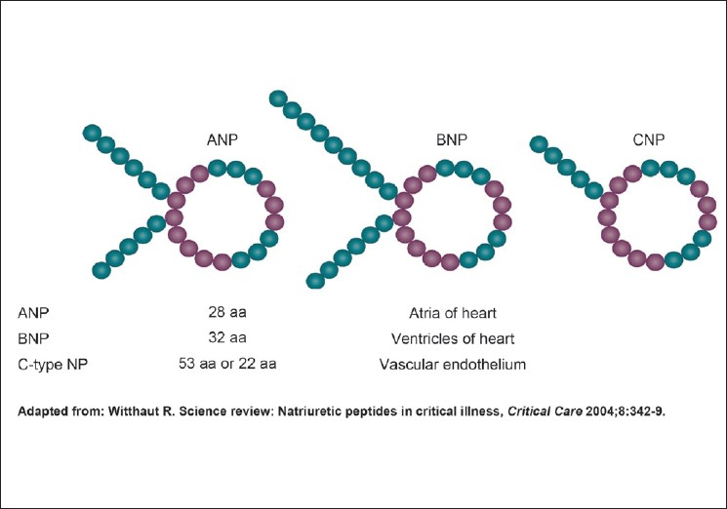
What is BNP?
A member of a family of four human natriuretic peptides that share a common 17-peptide ring structure (ANP, CNP, DNP)
Stored as proBNP in the ventricles
When proBNP is secreted - cleaved to the biologically inert N-terminal fragment (NT-proBNP) and the biologically active hormone BNP
Multiple studies have shown correlation with BNP levels and increasing CHF symptoms

Slide 8
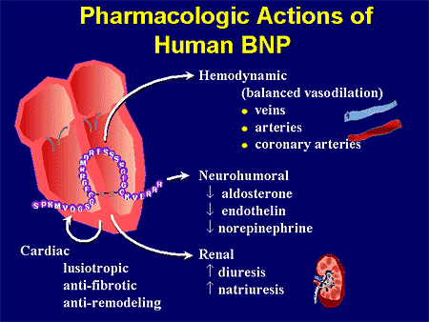
High ventricular filling pressures stimulate the release of ANP and BNP. Both peptides have diuretic, natriuretic, and antihypertensive effects, which they exert by inhibiting the renin-angiotensin-aldosterone system. They also have systemic and renal sympathetic activity

Slide 9
Why use BNP?
Landmark Breathing Not Properly (BNP) study¹ (n1596) showed that at an 80% cutoff level of certainty of CHF, clinical judgment had a sensitivity of 49% and specificity of 96%
At 100 pg/mL, BNP had a sensitivity of 90% and specificity of 73%
Adding BNP to clinical judgment would have enhanced diagnostic accuracy from 74% to 81%
BASEL study² (n452) compared routine care with addition of BNP; BNP use reduced the need for hospitalization and intensive care 75% vs 85% (P=0.008). The median time to discharge was 8 days in the BNP group and 11 days in the control group (P=0.001)
1. McCullough et al Circulation. 2002;106:416-422
2. Mueller et al NEJM 2004;350(7):647-54

Slide 10
What does NICE say?
“In people presenting with new suspected acute heart failure, use a single measurement of serum natriuretic peptides (B-type natriuretic peptide [BNP] or N-terminal pro-B-type natriuretic peptide [NT-proBNP]) and the following thresholds to rule out the diagnosis of heart failure:
BNP less than 100 ng/litre
NT-proBNP less than 300 ng/litre”
Acute heart failure: diagnosis and management 2014
nice.org.uk/guidance/cg187

Slide 11
BNP in acute HF is now a NICE Quality Standard!
Quality statement 1
Adults presenting to hospital with new suspected acute heart failure have a single measurement of natriuretic peptide
Quality statement 2
Adults admitted to hospital with new suspected acute heart failure and raised natriuretic peptide levels have a transthoracic doppler 2D echocardiogram within 48 hours of admission
(no mention of levels of ‘raised’)

Slide 12
So what is ‘raised’?
BNP
<100ng/L – ‘normal’
>100-500ng/L – ‘mid-range’ - consider HF
>500ng/L – ‘raised’ –treat as HF, echo ≤ 48hrs
NT-proBNP
<300ng/L - ‘normal’
300-1800ng/L -’mid-range’ – consider HF
>1800ng/L – ‘raised’ – treat as HF, echo ≤ 48hrs

Slide 13
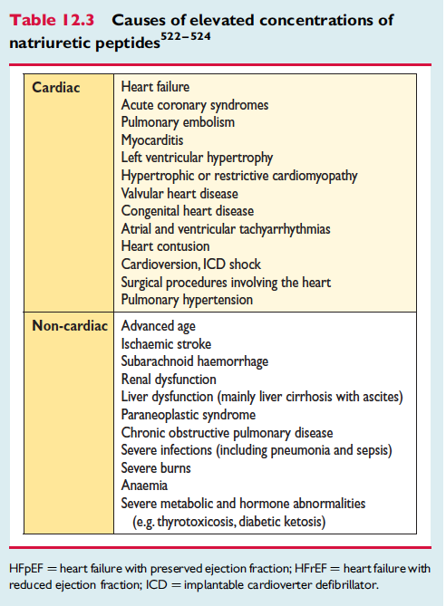
But it’s not that straight-forward

Slide 14
And BNP levels are lower in:
Obesity – BMI >30:
To achieve 90% sensitivity, the BNP cut-point in the lean patients is BNP ≥170 pg/mL, whereas in the severely/morbidly obese patients, the equivalent cut-point is only 54 pg/mL ¹
Flash pulmonary oedema
Treatment with ACEI/ARBs/diuretics/spironolactone
1. Lori et al Am Heart J. 2006;151(5):999-1005

Slide 15
So what should you do in patients with acute dyspnoea?
Take a detailed history, assessing symptoms, prior CVS hx and potential precipitants
Clinical examination and assess for
signs of congestion and/or hypoperfusion
ECG
(completely normal in <2% of 9315pts with HF in EuroHeart survey¹)
CXR (other causes of dyspnoea, NB 20% can be near-normal)
Blood tests – including BNP when unclear diagnosis
1.Khan et al. European Journal of Heart Failure 9 (2007) 491 – 501

Slide 16
Our initial experience of NT-proBNP
N=146
<300ng/L = 24 (16%)
300-1800ng/L = 39 (27%)
>1800 ng/L = 76 (52%)
At a cost of £4015!

Slide 17
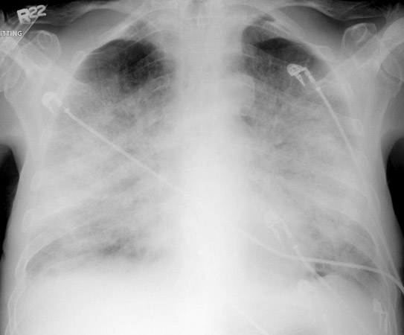
Do you need to use BNP here?

Slide 18
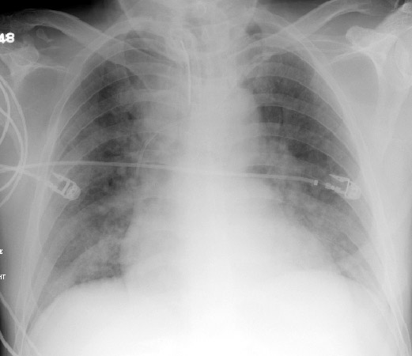
Or here?

Slide 19
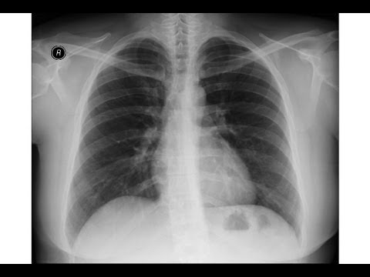
Maybe here?

Slide 20
What about troponins?

Slide 21
What is Troponin
Troponin is a complex of three regulatory proteins (troponin C, troponin I, and troponin T) that is integral to muscle contraction in cardiac and skeletal muscle (but not smooth muscle)
Troponin is a component of thin filaments (along with actin and tropomyosin), and is the protein complex to which calcium binds to trigger the production of muscular force
Certain subtypes of troponin (cardiac troponin I and T) are very sensitive and specific indicators of damage to the heart muscle

Slide 22
The indications for checking Troponin
Suspected ACS
Suspected ACS
Suspected ACS
Suspected ACS
NOT:
‘collapse’ ‘generally unwell ‘off legs’

Slide 23
Acute Coronary Syndrome
Ischaemic Discomfort Unstable Symptoms
History and
Physical Exam
No ST-segment elevation
ST-segment elevation
ECG
Unstable
angina
Biochemical
markers
NSTEMI
STEMI

Slide 24
Biochemical evaluation
Only cardiac troponin T and I are expressed in cardiac muscle and released into blood following myocardial cell death
Use of high sensitivity troponin assays allows more accurate and earlier detection of MI.

Slide 25
How does an ACS present?
1) Sudden death
2) Chest pain
3) Chest pain
4) Chest pain
5) Acute LVF
6) Nausea and vomiting
7) Syncope/presyncope – usually inferior STEMI with CHB or NSVT

Slide 26
Clinical presentation of ACS
GRACE Registry, n=20 881
Chest pain, n=19 121 (92%)
No chest pain, =1763 (8%)
Dyspnoea, n=869 (4.1%)
Diaphoresis, n=462 (2.2%)
Nausea and vomiting, n=426 (2%)
Syncope/presyncope, n=335 (1.6%)
(NSTEMI = at least one positive cardiac biochemical marker of necrosis without new ST-segment elevation)
Brieger et al Chest. 2004;126(2):461-469.

Slide 27
What exactly is a Myocardial Infarction?
The term acute myocardial infarction (MI) should be used when there is evidence of myocardial necrosis in a clinical setting consistent with acute myocardial ischaemia. The criteria include:
Detection of a rise and/or fall of cardiac biomarkers (preferably cTn) with at lease 1 value above the 99% upper reference limit and with at least one of the following:
Symptoms of ischaemia
New or presumed new ST-segment, T-wave changes or new LBBB
Development of pathological Q waves on the ECG
Imaging evidence of new loss of viable myocardium or new regional wall motion abnormality
Identification of an intracoronary thrombus by angiography or autopsy
Third Universal Definition of myocardial infarction.
European Heart Journal (2012) 33, 2551-2567

Slide 28
And did you know that there are more than one type of MI?

Slide 29
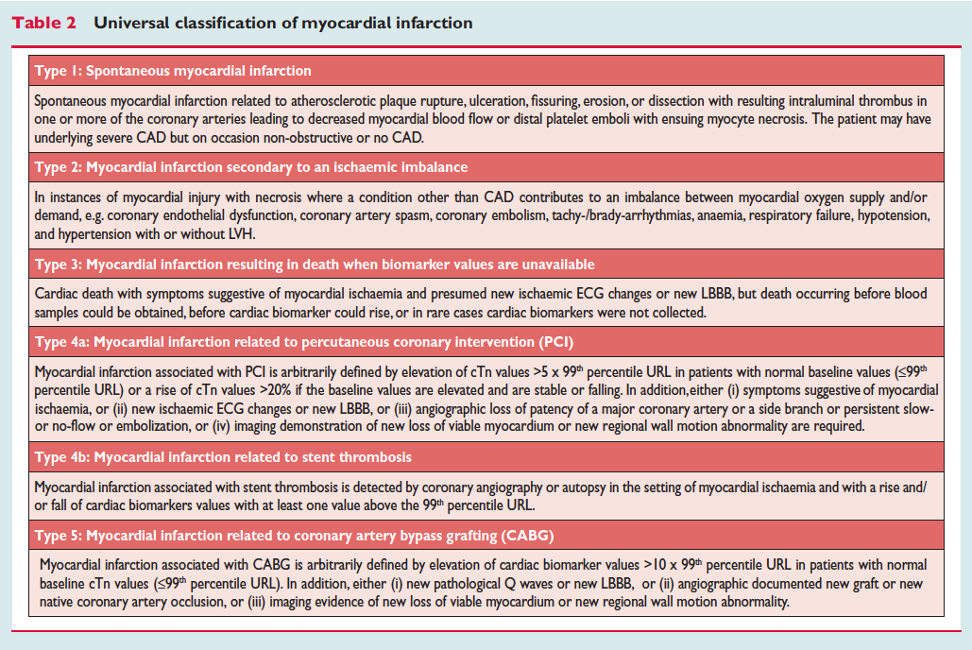

Slide 30
How do you manage a type 2 MI?
i.e. how do you treat secondary myocardial injury?
By treating the underlying cause
Not with ACS management

Slide 31
Causes of an elevated Troponin
Elevations of cardiac troponin values because of myocardial injury
Injury related to primary myocardial ischaemia
Plaque rupture
Intraluminal coronary artery thrombus formation
Injury related to supply/demand imbalance of myocardial ischaemia
Tachy-/bradyarrhythmias
Aortic dissection or severe aortic valve disease
Hypertrophic cardiomyopathy
Cardiogenic, hypovolaemic, or septic shock
Severe respiratory failure
Severe anaemia
Hypertension with or without left ventricular hypertrophy
Coronary spasm
Coronary embolism or vasculitis
Coronary endothelial dysfunction without significant coronary artery disease

Slide 32
Injury not related to myocardial ischaemia
Cardiac contusion, surgery, ablation, pacing, or defibrillator shocks
Rhabdomyolysis with cardiac involvement
Myocarditis
Cardiotoxic agents, for example, anthracyclines, trastuzumab (Herceptin)
Multifactorial or indeterminate myocardial injury
Heart failure
Stress (takotsubo) cardiomyopathy
Pulmonary embolism or severe pulmonary hypertension
Sepsis and critically ill patients
Renal failure
Severe acute neurological diseases, for example, stroke, subarachnoid haemorrhage
Infiltrative diseases, for example, amyloidosis, sarcoidosis
Strenuous exercise
Electroconvulsive therapy

Slide 33
So......
There are many clinical conditions other than myocardial infarction that cause troponin elevation
High sensitivity Troponin increases the sensitivity but decreases the specificity
Troponin elevation merely indicates the presence, not the mechanism, of myocardial injury.

Slide 34
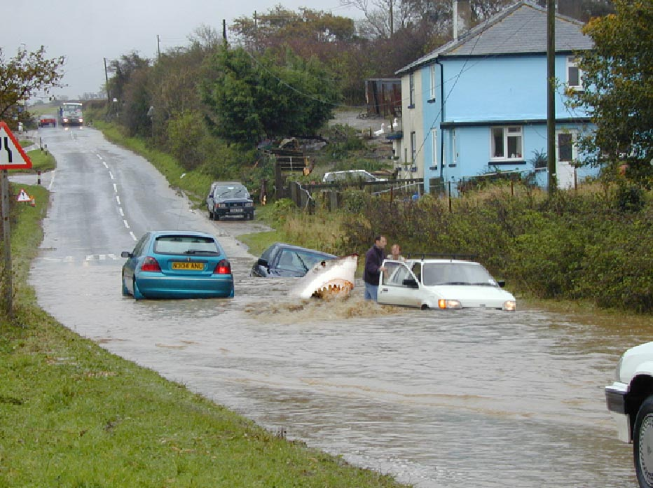
Use Troponins wisely!

Slide 35
How it can go wrong
84 Female
Admitted with :Collapse – found on bathroom floor
Denies :Chest pain, SOB, palpitations, dizziness
PMHx:
HTN
CKD III
Recurrent Falls

Slide 36
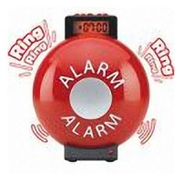
Examination:
GCS 15, but noted to be a bit sleepy
BP 200/90mmhg
HR 57 regular
Chest:clear, JVP(-), HS:I-II , no peripheral oedema
No signs of cardiac decompensation
No neurological Deficit
HS Troponin in A+E = 58
eGFR = 50
Lab troponin 1=231, lab troponin 2=217

Slide 37
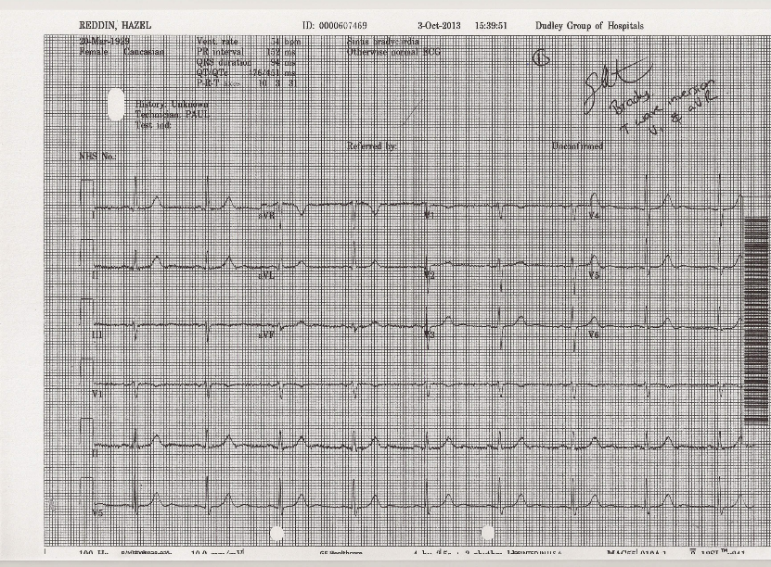

Slide 38
Differential Diagnosis in EAU:
ACS
Syncopal Episode
Mechanical fall
Principle working diagnosis: NSTEMI
Given Aspirin/Clopidogrel/Enoxaparin

Slide 39
What exactly is a Myocardial Infarction?
The term acute myocardial infarction (MI) should be used when there is evidence of myocardial necrosis in a clinical setting consistent with acute myocardial ischaemia. The criteria include:
Detection of a rise and/or fall of cardiac biomarkers (preferably cTn) with at lease 1 value above the 99% upper reference limit and with at least one of the following:
Symptoms of ischaemia
New or presumed new ST-segment, T-wave changes or new LBBB
Development of pathological Q waves on the ECG
Imaging evidence of new loss of viable myocardium or new regional wall motion abnormality
Identification of an intracoronary thrombus by angiography or autopsy
Third Universal Definition of myocardial infarction.
European Heart Journal (2012) 33, 2551-2567

Slide 40
What can cause a ‘collapse’ and raise the troponin?
Bradyarrythmia
Tachyarrhythmia
Pulmonary Embolism
Sepsis – urinary/chest
Stroke/subarachnoid
ACS
Acute Kidney Injury
Hypertensive crisis
Acute aortic dissection
Hypovolaemic shock
Rhabdomyolysis
Severe anaemia

Slide 41
Progress
Admitted to CCU on day 2
ACS Protocol
Suddenly complains of a headache
BP: 230/70
Right pupil fixed and dilated
Sudden drop in GCS 15 – 8
Urgent CT head – acute on chronic subdural haematoma with midline shift
Discussed with Neurosurgeons – not for active treatment
Dies a few hours later

Slide 42
“When troponin was a lousy assay it was a great test, but now that it’s becoming a great assay, it’s getting to be a lousy test.”*
*Robert L. Jesse, M.D., Ph.D. Chief Academic Affiliations Officer for the U.S. Department of Veterans Affairs

Slide 43
Summary and learning points
Most patients with a true ACS present with chest pain
Troponin is a very sensitive marker of myocardial damage but it is not specific for a type 1 MI
Many conditions cause an elevated Troponin
Only check Troponin in patients with chest pain or new ST/T wave changes on ECG

Slide 44
Summary and learning points
BNP is a great test at ruling out acute heart failure with a high sensitivity but a low specificity
Lots of other conditions (PE/COPD/CKD/liver cirrhosis etc) result in elevated levels of BNP
NICE guidance states that all patients presenting with suspected acute HF should have a single BNP. My interpretation is that you should follow this advice after you have made your initial clinical assessment with ECG and CXR.

Slide 45
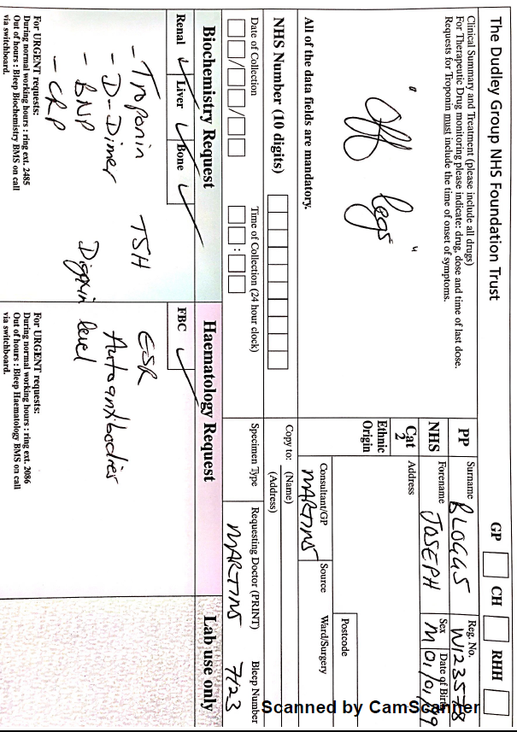
This is not good medicine!

Slide 46
Think before you treat as an ACS or HF

